Slide 1



Joint Review

Slide 2

Definitions/Acronyms:
Term/Acronym | Definition
A-SPICE | Automotive Software Process Improvement and Capability Determination
SYS | System Engineering
SWE | Software Engineering
Workflow | Definition, execution and automation of business processes where tasks, information or documents are passed from one participant to another for action, according to a set of procedural rules.
Trace | Link between two meaningful contents in a document

Slide 3
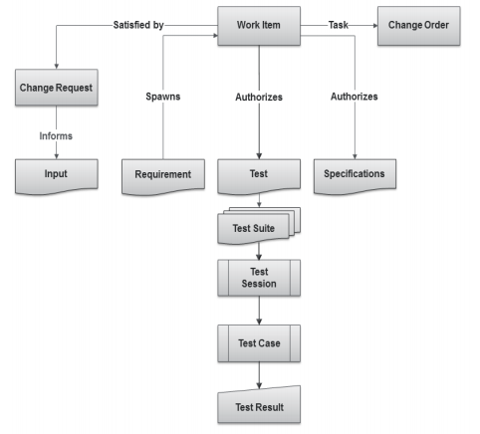
What Are Items?
  Items are the basic building blocks of the Integrity data model, and represent the information assets and process objects associated with software development.
  For example, items can represent Work items, projects, requirements, test cases, change requests, and defects.
  Every item is configurable and contains metadata and history about that item.
  Every item type has its own enforceable workflow which describes how it moves from state to state, complete with definable rules, full audit trails, and security.
  Escalations, conditional assignments, notifications, and external processes can all be defined and initiated as part of Integrity’s process automation

Slide 4
Creating Joint Review

Slide 5
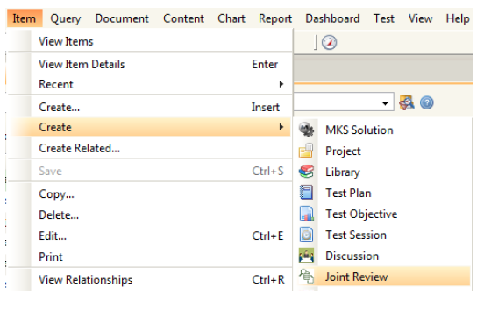
Creating Joint Review
Select Create in Item menu to create a new Joint Review Item in Integrity.
Steps:
1.Creating Joint Review
2.Editing data in Item view
3.Applying changes in created item
4.Item Details View
5.Joint Review Workflow

Slide 6
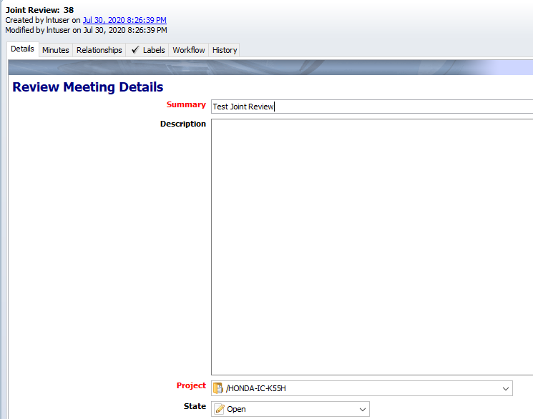
Creating Joint Review
Item details view will open up. Enter or select correct values for the fields present. Enter values in all fields. Mandatory fields are marked Red.
Steps:
1.Creating Joint Review
2.Editing data in Item view
3.Applying changes in created item
4.Item Details View
5.Joint Review Workflow

Slide 7
Creating Joint Review
All other fields visible in the Item Details view must be filled.
Clicking on “Apply” will keep the user on the same screen while clicking on “OK” will show the user a non-editable form-like view.
Clicking “Apply” will save the document. Alternately “Ctrl + S” can also be used.
Click on “OK” to finish creating.
Steps:
1.Creating Joint Review
2.Editing data in Item view
3.Applying changes in created item
4.Item Details View
5.Joint Review Workflow

Slide 8
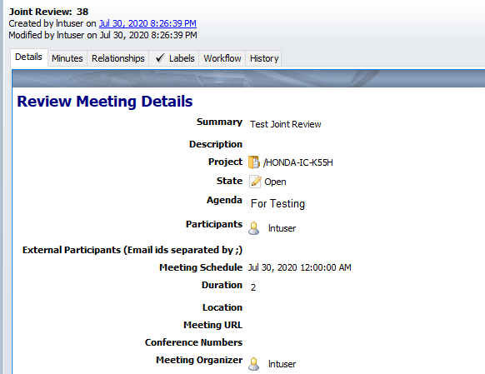
Creating Joint Review
Once user clicks on “Apply”, the Item Details view will appear as follows
Steps:
1.Creating Joint Review
2.Editing data in Item view
3.Applying changes in created item
4.Item Details View
5.Joint Review Workflow

Slide 9
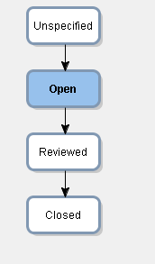
Creating Joint Review
The workflow will be as follows:
Steps:
1.Creating Joint Review
2.Editing data in Item view
3.Applying changes in created item
4.Item Details View
5.Joint Review Workflow

Slide 10
Joint Review –Details Tab
The Details tab contains the following fields:
Summary: Short Title for the Joint Review
Description: Brief introduction of the Joint Review Item
Project: Project for which the Joint Review will take place
State: State of the item based on workflow. (Default state selected will be “Open”)
Agenda: Points to be covered in the Joint Review with all details
Participants: Select participants (within Organization) for the Joint Review
External Participants: Enter E-mails of Participants other than Organization separated by ‘;’ (semi-colon)
Meeting Schedule: Select date and time for Joint Review from the Calendar
Duration: Mention Duration of Joint Reviews in hours
Location: Mention Venue for Joint Review
Meeting URL: Mention Meeting URL or link if the Joint Review is taking place online. (If Any)
Conference Numbers: Type Conference call numbers
Meeting Organizer: Select name of the person that has organized this meeting (it can be the user who creates the Joint Review)

Slide 11
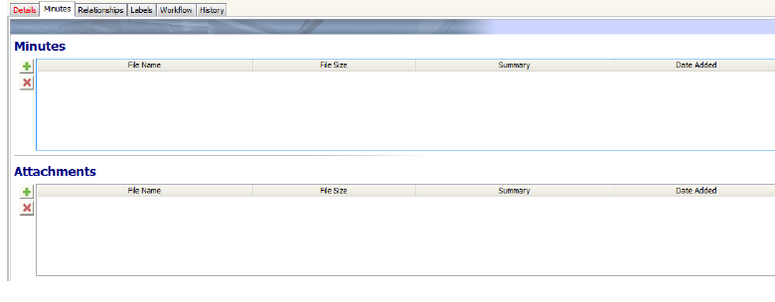
Joint Review –Minutes Tab
Attachment tab avails users to add item related files to the Joint Reviews:
₋Minutes–Attach MOMs
₋Customer Attachments –Related files discussed during Joint Reviews or that are part of Joint Review
Note: Attachments can be of any file format. It should not exceed the size of 5MB.

Slide 12
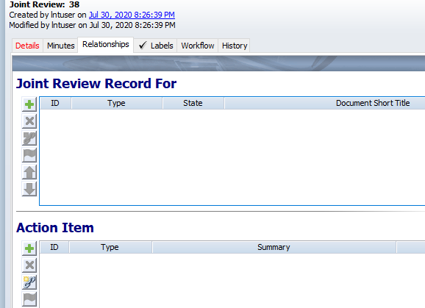
Joint Review – Relationships Tab
The Relationships tab include the following fields:
Joint Review Record For: User can attach Related document to this field for which the Joint Review is carried out.
  Also the user can create related item by clicking on symbol.
  Related document is Stakeholders Requirement Document.
Action Item: User can attach action items to this fields that are related to this Joint Review based on project.

Slide 13
Reviewing the Joint Review
Once the Joint Review is over, the Meeting Organizer is responsible to change the state to Reviewed.
To inform about Joint Review being Reviewed:
  Edit the required Joint Review by right clicking and select “Edit Item”.
  Change the state of the Joint Review from Open to Reviewed.
  Changing the state to Reviewed will make the following fields mandatory before applying changes.
    Joint Review Summary (Last field in Details Tab)
    Joint Review Record For (Relationships Tab)
    Minutes(Attachment Tab)
  Fill the mandatory fields and click on “Apply” button.

Slide 14
Closing the Joint Review
Once the Joint Review is over, the Meeting Organizer is responsible to change the state to Closed.
To inform about Joint Review being Closed:
  Edit the required Joint Review by right clicking and select “Edit Item”.
  Change the state of the Joint Review from Open to Closed.
  Before saving changes make sure all mandatory fields and information is correctly entered.
  Fill the mandatory fields and click on “Apply” button.

Slide 15
Reviewing the Joint Review
Once the Joint Review is over, the Meeting Organizer is responsible to change the state to Reviewed.
To inform about Joint Review being Reviewed:
  Edit the required Joint Review by right clicking and select “Edit Item”.
  Change the state of the Joint Review from Open to Reviewed.
  Changing the state to Reviewed will make the following fields mandatory before applying changes.
    Joint Review Summary (Last field in Details Tab)
    Joint Review Record For (Relationships Tab)
    Minutes(Attachment Tab)
  Fill the mandatory fields and click on “Apply” button.

Slide 16

Thank you
Thank you

